Slide 1

Applying to
Ontario’s Universities
Undergraduate Application
Instructions for Ontario High School Students
www.ouac.on.ca/undergrad-guide

Slide 2
Step 1:
Research Your University Options
      Visit OUInfo (www.ouinfo.ca) to find what each university has to offer.
      Read the Undergraduate Application Guide (www.ouac.on.ca/undergrad-guide) for
      up-to-date information about universities and programs.
      Check out university publications and websites.
      Talk to counsellors, family, teachers and friends.
      Write down your program choices and codes and keep them handy.
Notes:
We encourage you to research your university options prior to logging in to the Undergraduate application. We recommend that you make a list of your program codes and keep it handy when you log in. This greatly reduces the time required to complete the application.

Slide 3
Step 2:
Get Your OEN
You will need your Ontario Education Number (OEN) to apply.
The OEN is a 9-digit, unique identification number assigned to elementary and high school students across the province.
You can find your OEN on your report card. Your high school guidance counsellor will also have it on record.
Notes:
In the Education section, under “Tell Us More”, you will be asked if you will receive your Ontario Secondary School Diploma by the end of the current school year. When you respond “Yes”, you will be prompted to add your OEN.

Slide 4
Step 3: Mark Your Calendar
      Late September 2024: The Undergraduate application opens.
      January 15, 2025: Deadline to submit your completed application to the OUAC.
      May 29, 2025: Last day you can expect a response from an Ontario university if you applied by the January 15 deadline.
      June 2, 2025: The earliest day you may be required to respond to an offer and give a financial commitment (e.g., registration or residence deposit).
Notes:
These dates are established by guidance counsellors, the Ontario universities and the OUAC. Individual high schools may have additional internal deadlines.
You should not wait until the last minute to submit your application – internet connections may be interrupted as the deadline approaches. January 15, 2025, is the application deadline. We will accept applications after this date, but certain limited enrollment programs may no longer be available.

Slide 5

Step 4: Apply!
Access the application at: www.ouac.on.ca.
Notes:
You will access the Undergraduate application at: www.ouac.on.ca.
Read the Undergraduate Application Guide for in-depth instructions about how to complete the application: www.ouac.on.ca/guide/undergrad-guide.

Slide 6
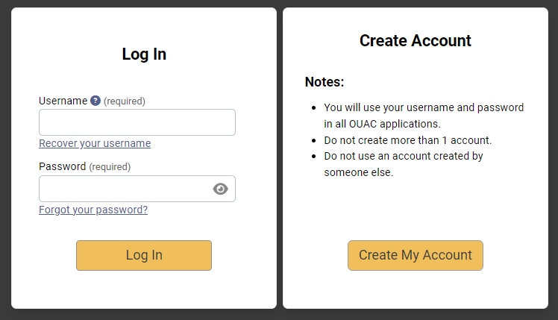
Creating an Account For the First Time
The first time you log in, you will need to create an account.
Notes:
You will provide basic personal information and create a username and password. You should create a username that is personal and easy for you to remember, as you will be using it to log in to your application from now on and to apply to all future OUAC applications.

Slide 7
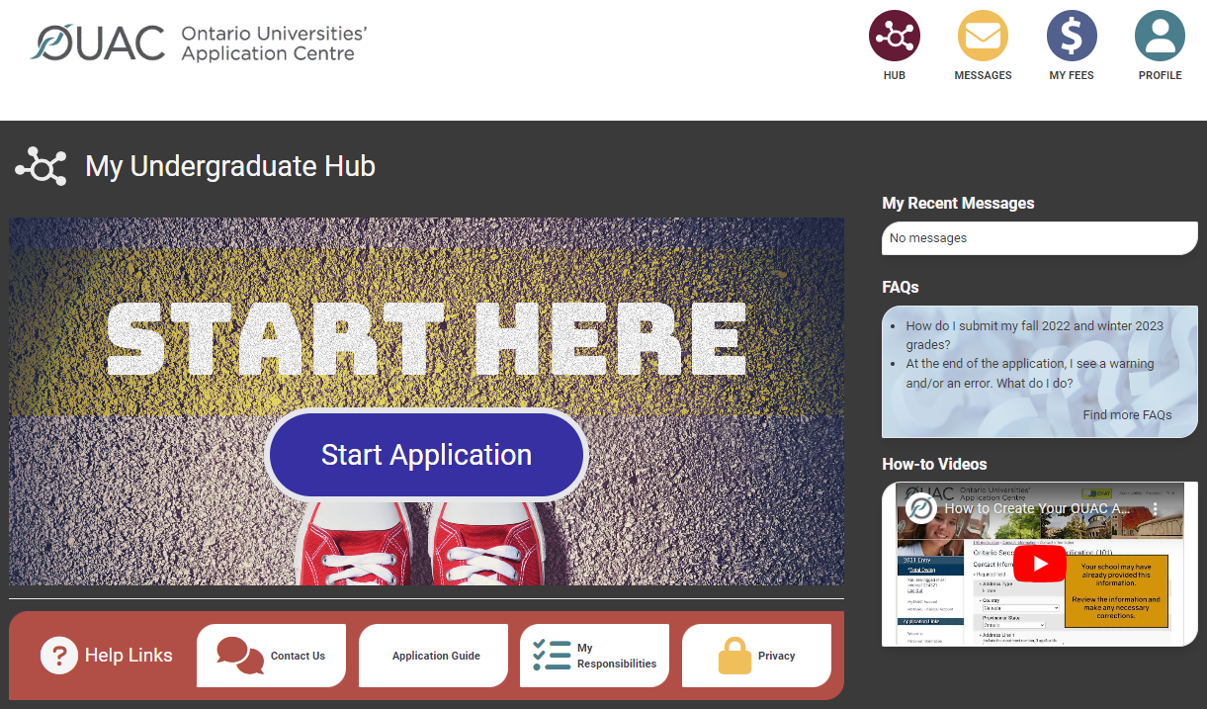
The Hub
The Hub is where you can access the different parts of your application and your Message Centre, and find a summary of the information you have added.

Slide 8
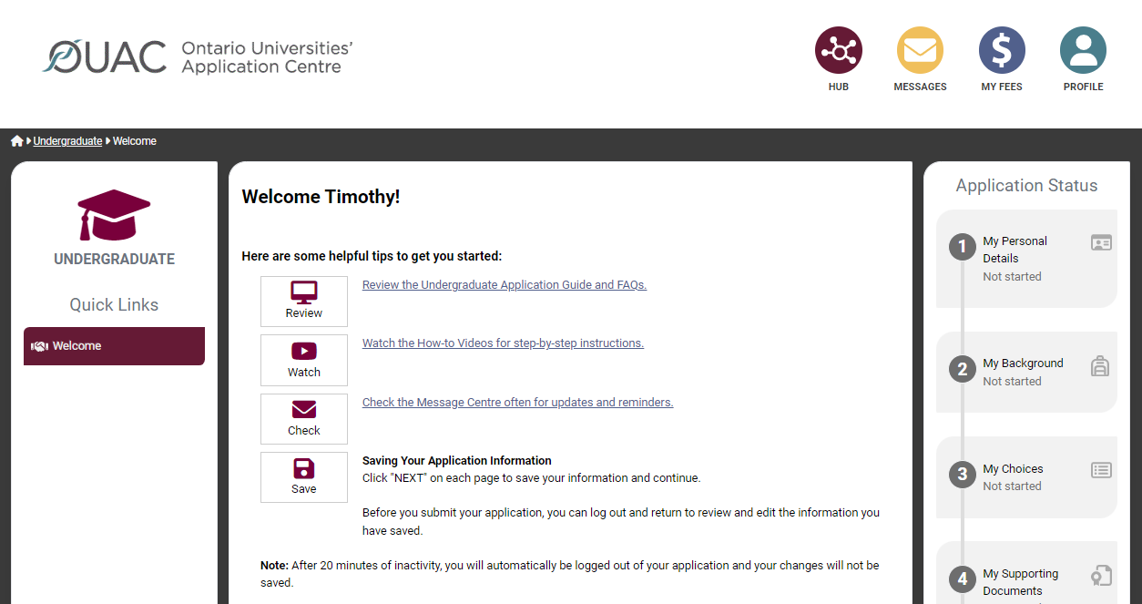
Welcome Page
Review the helpful tips on the Welcome page.

Slide 9
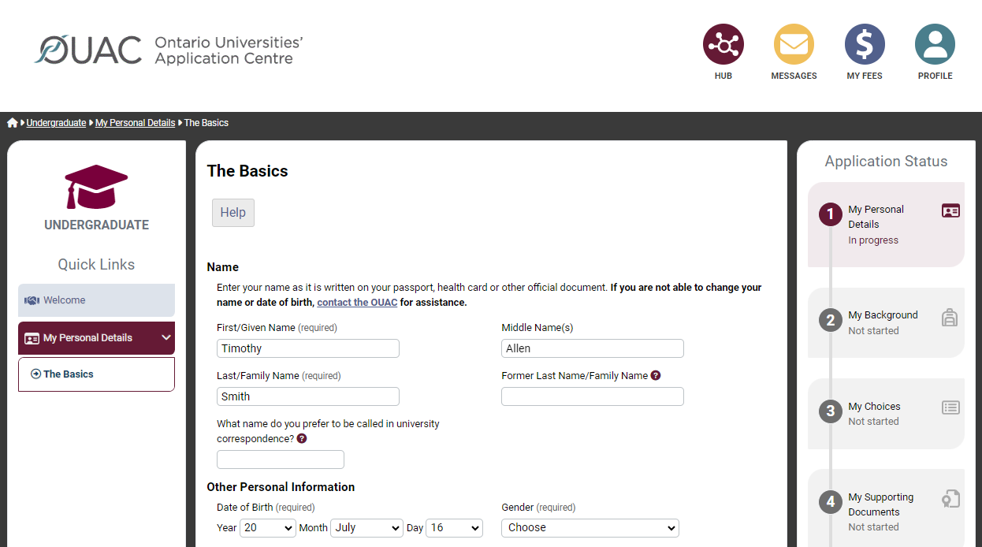
Navigating the Application
Notes:
The Quick Links menu appears on the left side of each page throughout the application (on a desktop computer). You are guided through the different sections of the application in order. The Application Status bar on the right side of each page shows you your progress through the application.

Slide 10
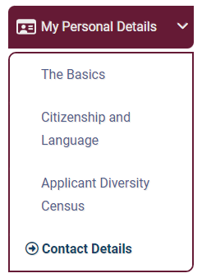
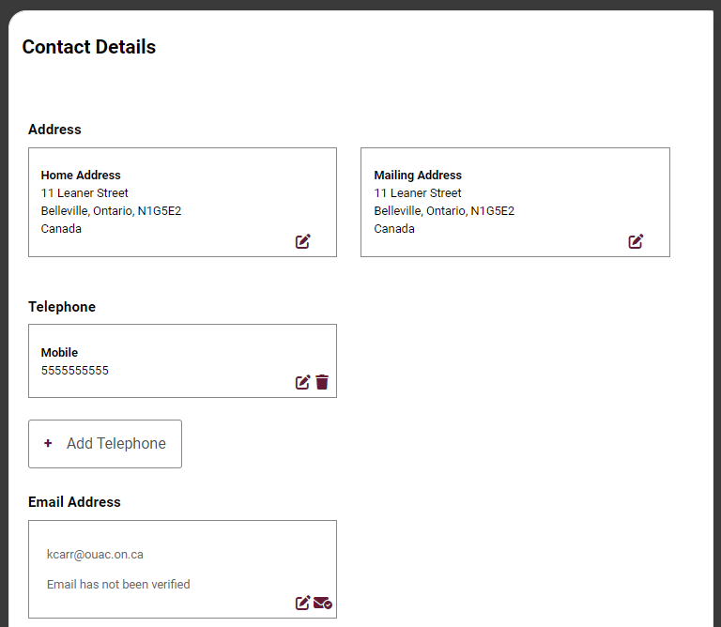
My Personal Details
You are not able to submit your application until you verify your email address.
Notes:
The My Personal Details section has 4 sub-sections: The Basics, Citizenship and Language, Applicant Diversity Census and Contact Details.
It is important that you provide all legal given names on The Basics page of My Personal Details. You should not use nicknames, abbreviations or initials.
You must enter your email address accurately, as the OUAC and the universities will correspond with you via email during the application process. We highly recommend you do not use school- or employer-issued email addresses.
When you create your OUAC account, you will receive an email asking you to click a link to verify your email address. You are not able to submit your application until you verify your email address. If you lose the email, you can re-send it to yourself through Contact Details.

Slide 11
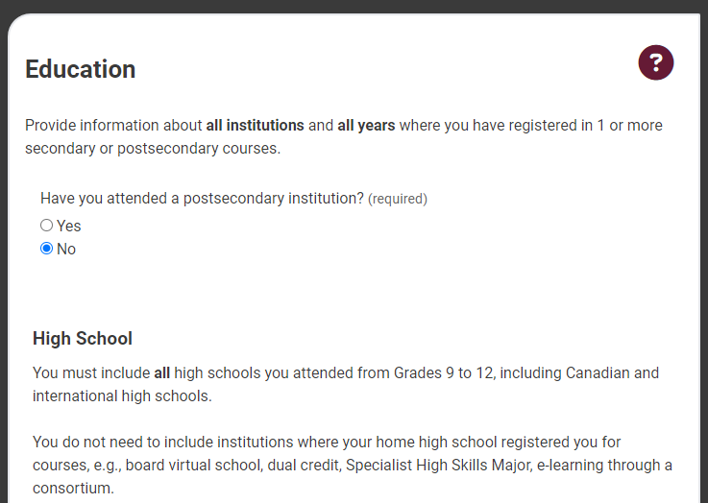
My Background – Education
Provide information about all institutions where you registered in 1 or more high school courses.
Provide information about postsecondary courses you have taken.
Notes:
Institutions may include: Regular day schools, private schools, night schools, summer schools and virtual schools.
You do not need to include institutions where your home school registered you for courses (e.g., virtual school, dual credit, Specialist High Skills Major, e-learning through a consortium).

Slide 12
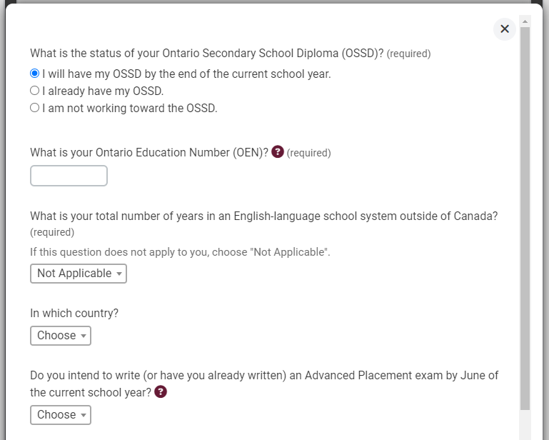
My Background – Tell Us More
Some fields are required. Select "Yes" to indicate you will achieve your OSSD, then add your OEN.
Notes:
After you add your institutions, you can tell us more details about your educational background.
You can find your OEN on your report card. Your high school guidance counsellor will also have it on record.

Slide 13

My Choices
You can search for programs by university, geographic area or program code.
Notes:
If you know the program codes of the programs you would like to apply to, you can add the program codes one at a time using the “By Program Code” search option.

Slide 14
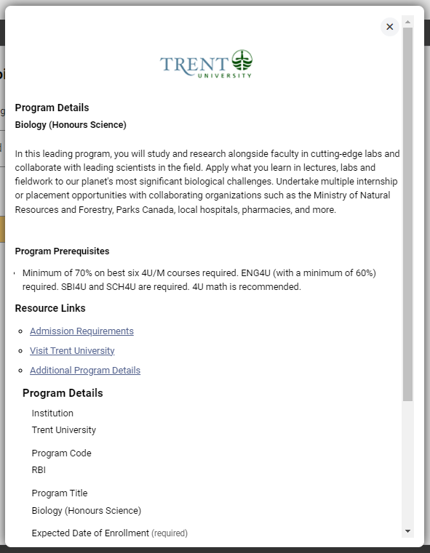
After You Have Selected a Program
Complete the program details for each program selected.
View the admission requirements for the program.
Notes:
Near the top of this page, you can view and confirm the admission requirements for the selected program.
You may apply to as many Ontario universities and programs as you wish; however, you are limited to a maximum of 3 program choices at any 1 university (including the university’s affiliates). Some universities may further limit the number of programs you may apply to.

Slide 15
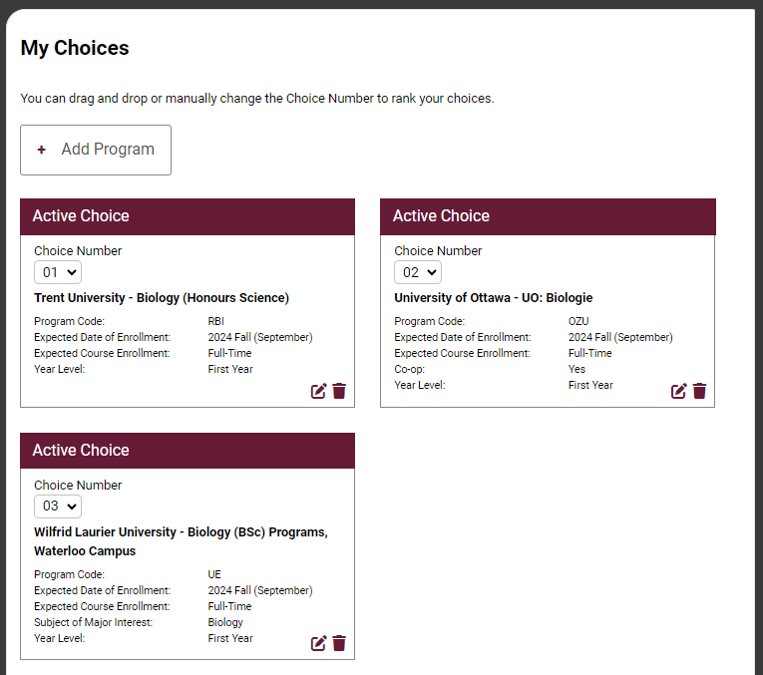
Order Your Choices
The choice order does not affect scholarship or admission consideration unless a university’s information specifically states that it does.
Notes:
Number or drag and drop your program choices in order of preference. Numbering does not affect scholarship or admission consideration unless a university specifically states this in its information. By default, program choices initially appear in the order that you selected them.

Slide 16
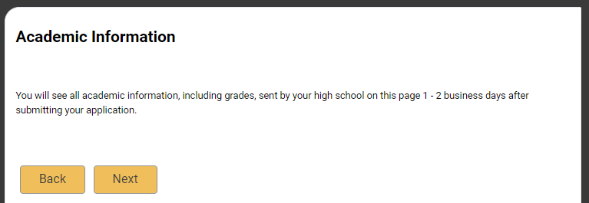
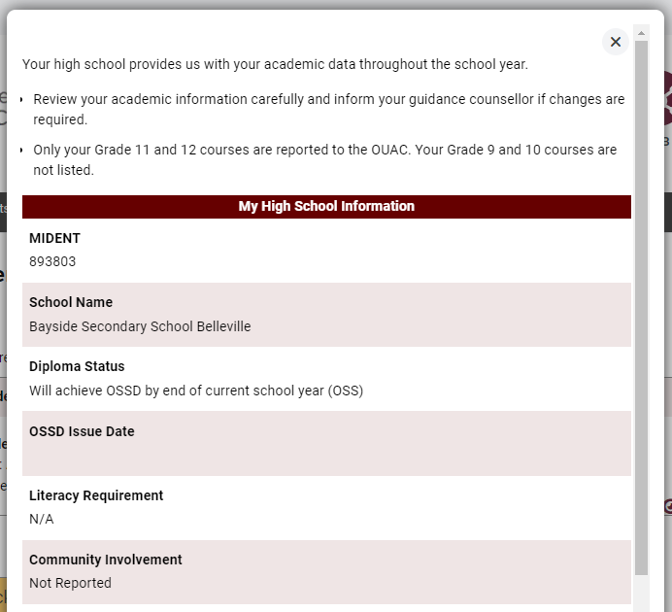
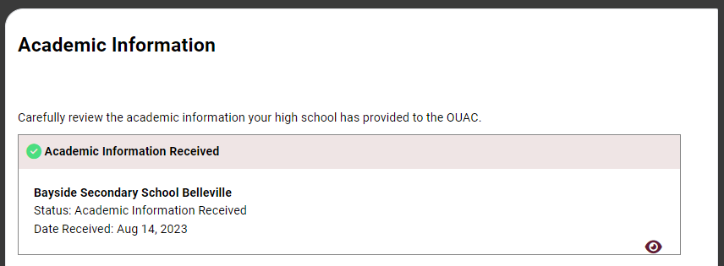
Academic Information
Monitor and report errors to your guidance counsellor.
This screen is read-only.
Notes:
Your high school provides your academic information, including grades, to the OUAC.
Any grades on file for you will be auto-matched after you submit your application and will continue to be matched as your school updates your grades throughout the school year. This information is read-only.
Log in to your application 1-2 business days after you submit to check your matched academic information carefully. Inform your guidance counsellor if you find any errors or do not see any grades.

Slide 17
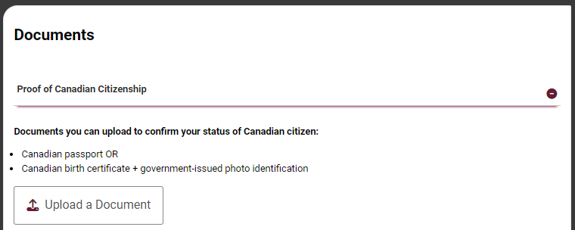
Document Upload
You can upload documents that support your application, as specified by your university choices.
Notes:
You can upload documents confirming proof of status in Canada and English-language test results, for example.

Slide 18
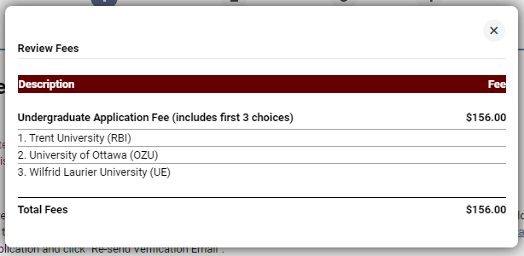
Fees
The cost is $156 for the first 3 university/program choices and $50 for each additional choice.
Notes:
You can view your fees in real time by clicking “My Fees”.

Slide 19
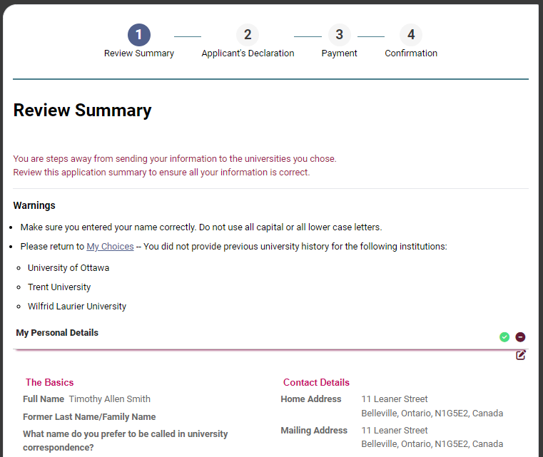
Review and Payment
Notes:
Once you have added all information to your application, you can proceed to “Review and Payment” to review a summary of all the information you entered. Select the eye icon to review the information in each tab.
You must read the Applicant’s Declaration and click “I Verify and Agree”. After you click “I Verify and Agree”, you will not be able to edit your application.

Slide 20
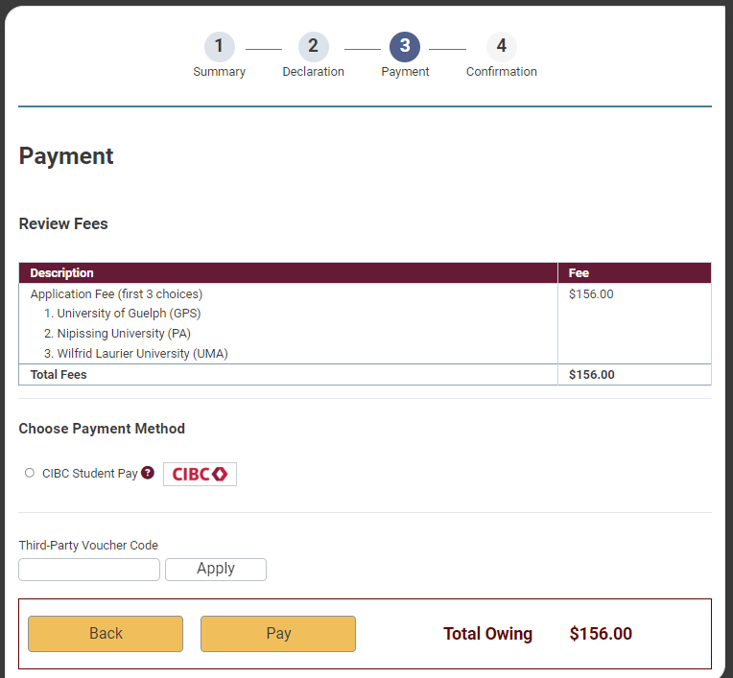
Paying for Your Application
Once you complete your payment, you will receive your OUAC Reference Number.
The OUAC cannot process your application without the application fee.
Notes:
To fully submit your application, you must select “CIBC International Student Pay” and click “Pay”.
The OUAC accepts payment through CIBC, a secure third party that allows you to make payments from within and outside Canada. You pay Canadian dollars in your local currency. When you click "Continue", you will be directed to CIBC to process your payment. When your transaction is complete, CIBC will send you a confirmation email. Click "Return to the OUAC" to return to your application.
Note: If your payment is declined or invalid, we will not process your application.
We will not distribute your application to your university choices until we receive and process your payment. You must make all payments at the same time you submit your application.

Slide 21
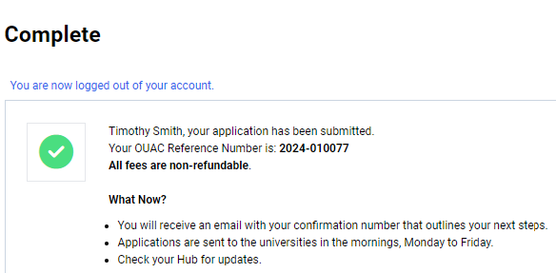
Submitting Your Application
On the Complete page, print the screen displaying your OUAC Reference Number (2025-XXXXXX) and instructions. You will also receive an email.
Record your OUAC Reference Number, as you will need to include it when communicating with the OUAC and the universities.
Notes:
Immediately after you submit your application, your OUAC Reference Number will be displayed. You should record your OUAC Reference Number, as you will need to provide it whenever you communicate with the OUAC or the universities.
You can view and/or make changes to your submitted application by logging in to your application at: www.ouac.on.ca/guide/undergrad-guide. You can view and/or make changes approximately 1 business day after you submit your application and your application fee payment is received and processed.

Slide 22
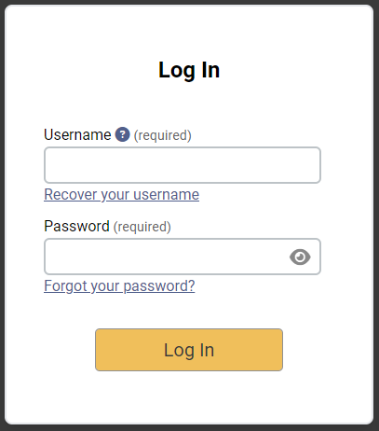
Reset Your Password
If you forget your password, click “Forgot your password?” on the Log In page.
Notes:
If you forget your OUAC account password, you can request a temporary password by clicking “Forgot your password?” on the Log In page. You must enter your username and email address. A link to reset your password will be emailed to you immediately. The link will expire in 1 hour.

Slide 23
Need Help?
Read the FAQ section on our website at: www.ouac.on.ca/faq.
Contact us:
OUAC
170 Research Lane
Guelph ON N1G 5E2
Telephone: 519-823-1063
Fax: 519-823-5232
Email: undergrad@ouac.on.ca
Website: www.ouac.on.ca/undergrad-guide
Notes:
Help with the application is available in several places, including the FAQs section on our website and from Applicant Services. Refer to the Undergraduate Application Guide for important details.
Visit OUInfo at www.ouinfo.ca to find and compare Ontario university programs, and research residences, scholarships, admission requirements and more.

